Slide 1

Campus Cybersecurity and Data Privacy
The Way Forward
CSPEN ANNUAL CONFERENCE
NASHVILLE, TENNESSEE
AUGUST 15, 2022
Notes:
Monday 2-3pm
Description:
As the challenges of securing an institutions data and systems increase each year, so too does the importance of leadership in this area beyond just the information technology department. This session, geared to all institution leaders, will discuss the ever-changing cyber risk landscape, ways to mitigate those risks, and the evolving regulatory requirements imposed by the federal government as a condition of continued access to federal systems key to student aid management.

Slide 2
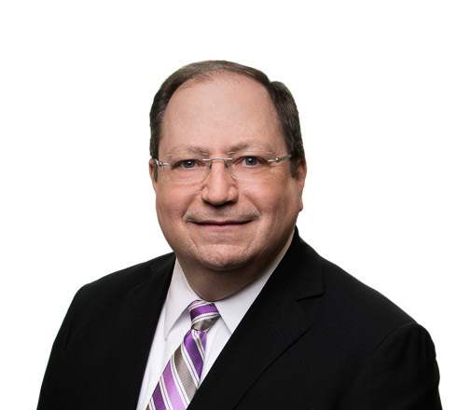


Who We Are
Roger Swartzwelder
202.868.5929
rswartzwelder@maynardcooper.com
Tres Cleveland
205.254.1183
tcleveland@maynardcooper.com
Adam Griffin
205.415.4903
agriffin@maynardcooper.com
Notes:
[Roger]
Introductions

Slide 3
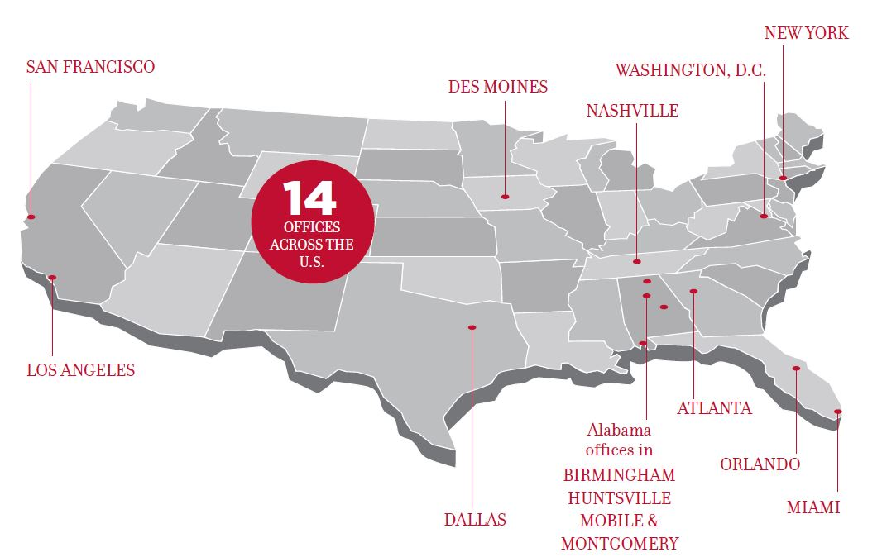
Where We Are
Notes:
[Roger]

Slide 4
Disclaimer
The purpose of this presentation is to provide news and information on legal and regulatory issues, and all content provided is for informational purposes only. It should not be considered legal advice.
The transmission of information from this presentation does not establish an attorney-client relationship with the participant or reader. The participant or reader should not act on the information contained in this presentation or any accompanying materials without first consulting retained legal counsel.
If you desire legal advice for a particular situation, you should consult an attorney.
Notes:
[Roger]

Slide 5
Agenda
Cybersecurity threat landscape and trends
GLBA revised Safeguards Rule
Impacts and practical considerations
Litigation perspective
Wrap-up and key takeaways
Notes:
[Roger]

Slide 6

Cybersecurity
Not just an IT issue
Everyone’s issue
Notes:
[Adam]
Building a culture of cybersecurity

Slide 7
Recent Trends and Statistics
95 percent of cybersecurity breaches are caused by human error (World Economic Forum)
Cyber fatigue, or apathy to proactively defending against cyberattacks, affects as much as 42 percent of companies. (Cisco)
Data breaches exposed 22 billion records in 2021. (RiskBased Security)
Notes:
[Adam]

Slide 8
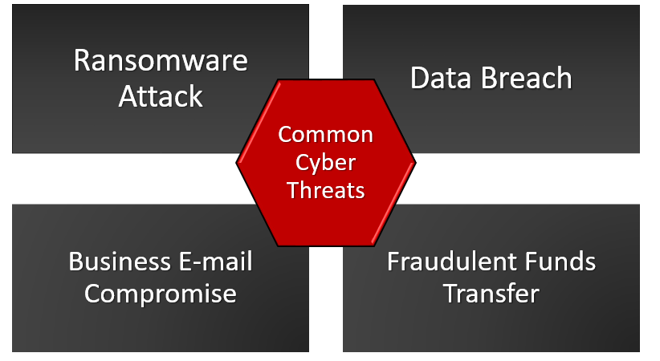
Notes:
[Adam]
Discuss/explain

Slide 9
You Are Targets
Sophisticated attackers
  Organized crime
“I can’t believe this happened to me”
Post-incident identification of cause
Targeting of IHEs
Notes:
[Adam]

Slide 10
Common Cyber Attack Vectors
Phishing email
Software or hardware vulnerability (e.g., unpatched firewall or VPN)
Pre-cursor malware
Compromised administrative credentials
Notes:
[Adam]
Usually someone lets them in – phishing email #1 most common

Slide 11
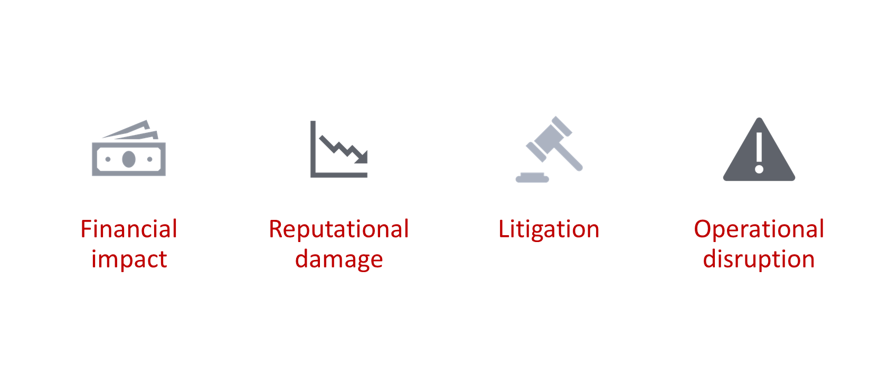
Effects can be severe:
and not limited to the IT department.
Notes:
[Adam]

Slide 12
How Do We Prevent These Attacks?
Phishing email awareness
Password hygiene
Multi-Factor Authentication Everywhere
Separation of work and personal devices/accounts
Be cautious using public wifi
Limit sharing of information on social media
When in doubt, ask
Notes:
[Adam]
Some of the ways to prevent incidents – not an exclusive list

Slide 13
GLBA
Gramm-Leach-Bliley Act (GLBA) was enacted in 1999 (Pub. L. No. 106-102)
    GLBA requires financial institutions to provide customers with information about the institutions’ privacy practices and about their opt-out rights, and to implement security safeguards.
    Subtitle A of Title V of the GLBA requires the FTC to issue regulations requiring financial institutions to develop standards relating to physical safeguards for certain information.
Notes:
[Adam]
Taking steps to prevent may not be optional if you fall under the new GLBA Safeguards Rule
What is GLBA?
The Federal Trade Commission considers institutions of higher education participating in federal financial aid programs authorized under the Higher Education Act to be covered financial institutions under GLBA
GLBA is enforced by the FTC for non-banking financial institutions

Slide 14
GLBA – Current Requirements
Develop, implement, and maintain a written information security program;
Designate the employee(s) responsible for coordinating the information security program;
Periodically evaluate and update your school’s security program;
Identify and assess risks to customer information; and
Select appropriate service providers that are capable of maintaining appropriate safeguards.
Notes:
However, FTC recently amended the safeguards rule, added a lot of specificity, more stringent requirements

Slide 15
GLBA – Revised Safeguards Rule Key Changes
Must prepare a written risk assessment including or addressing:
  Criteria for evaluating identified risks faced by the financial institution;
  Criteria for the assessment of the confidentiality, integrity, and availability of the financial institution’s information systems and customer protection; and
  How identified risks will be mitigated or accepted based on the risk assessment and how the information security program will address the financial institution’s risk.
Notes:
[Adam]

Slide 16
GLBA – Revised Safeguards Rule Key Changes
Must develop and implement an incident response plan
  Specific requirements it must address
Must design and implement safeguards to control risks, including:
  Access controls
  Encryption
  Data classification
  MFA
  Disposal
  Logging
Notes:
[Adam]
Some of these are what we already talked about – preventative
Also going to be required by your cyber insurance carrier, which you want to have

Slide 17
GLBA – Revised Safeguards Rule Key Changes
Must designate a qualified individual responsible for the information security program
Individual must submit information security report at least annually to the board
  Specific information must be included such as status, material matters, recommended changes
Training requirements, including security awareness
Periodic assessment of service providers (vendors)
Notes:
[Adam]

Slide 18
Revised Safeguards Rule Compliance
Partial exemption for small entities
Final rule effective January 10, 2022
Some portions effective December 9, 2022, including:
  Appointment of a qualified Individual
  Written risk assessments
  Written incident response plan
Notes:
[Adam]
Small entity exemption:
Institutions that collect information about fewer than 5,000 consumers
Exempted from certain requirements only:
Written risk assessment
IRP
Annual reporting

Slide 19
Impact
The U.S. Department of Education will require compliance with the revised Rule.
Compliance with GLBA is a specific requirement in the PPA and will be reviewed in the compliance audit:
  Is there an identified information security program coordinator?
  Has the school done a risk assessment covering employee training, information systems, and attack detection, prevention and response?
Costs of compliance are borne by the institution.
Notes:
[Roger]

Slide 20
What To Do Now
Time to prepare for compliance with the revised Rule is now
For GLBA compliance and to prevent cyber incidents:
  Ensure that the school has a qualified professional in charge of cybersecurity policies and compliance
  Conduct comprehensive risk assessment and document a safeguard for each risk.
  Legal compliance analysis of current plans and documents
Notes:
[Roger]

Slide 21
Leadership Involvement
Presidents and Chief Information Officers of Institutions should have, at a minimum:
  Evaluated and documented their current security posture against the requirements of GLBA
  Taken immediate action to remediate any identified deficiencies. (DCL GEN-16-12)
  Established policies and procedures for each cybersecurity phase:
    Identify, protect, detect, respond, and recover
Leadership, including the Board of Directors, must show strong support for the school’s compliance efforts
Establish solid working relationship with your cybersecurity staff
Notes:
[Roger]

Slide 22
Litigation Perspective
Data breaches can lead to class actions
Cost of defense/impact of class action
Notes:
[Tres]

Slide 23
Key Takeaways
Cybersecurity risks are shared by everyone
Time to work towards GLBA compliance is now
  Comprehensive risk assessment
  Board and leadership education/engagement
Your institution will bear the burden of GLBA compliance
  Potential penalties for noncompliance
Seek to avoid post-incident litigation

Slide 24
Questions?
Roger Swartzwelder
202.868.5929
rswartzwelder@maynardcooper.com
Tres Cleveland
205.254.1183
tcleveland@maynardcooper.com
Adam Griffin
205.415.4903
agriffin@maynardcooper.com
Notes:
Just an overview - Follow up sessions for certain groups

